Slide 1







Table of contents
View in Presentation mode
0
1
2
3
4
5
6
0
min
Table of content
Introduction
Solution
Schematics
Conclusion

Slide 2
Introduction
Introduction
The Clients Request
Table of content
Introduction
Solution
Schematics
Conclusion
0
1
2
3
4
5
6
0

Slide 3


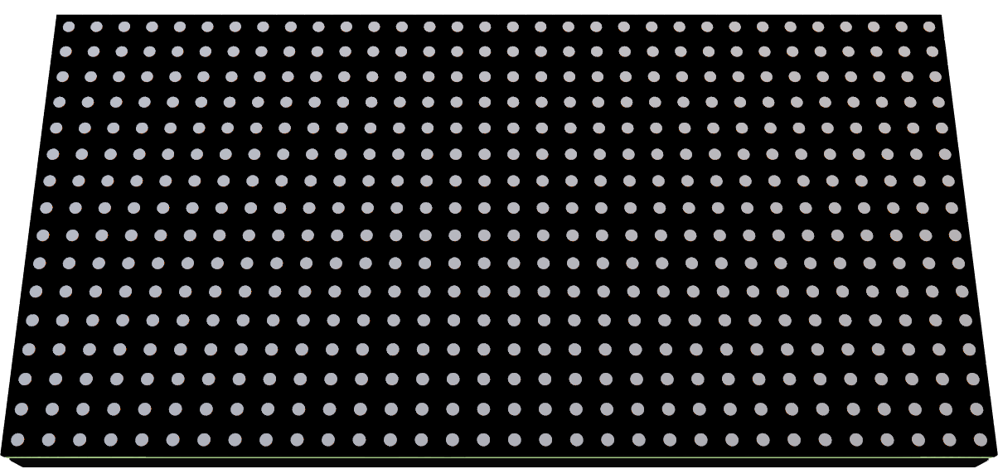
Table of contents
Introduction
The Clients Request
0
1
2
3
4
5
6
0
min
Table of content
Introduction
Solution
Schematics
Conclusion

Slide 4
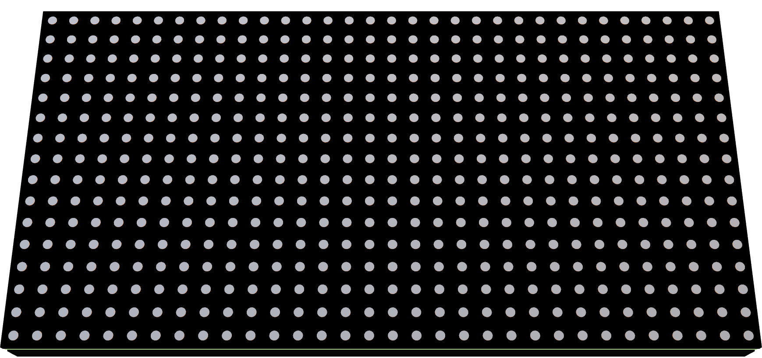
Table of contents
The Clients Request
0
1
2
3
4
5
6
0
min

Slide 5

Introduction
The Clients Request
Battery powered wirelessly configurable RGB Matrix Display
0
1
2
3
4
5
6
0
min

Slide 6

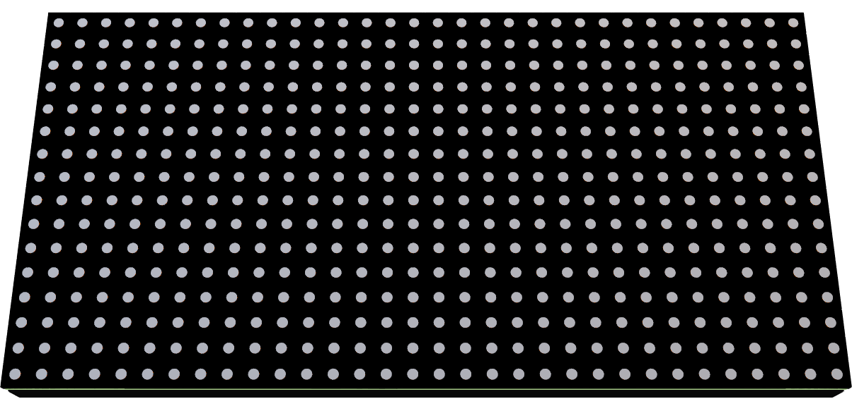
0
1
2
3
4
5
6
0
1
2
3
4
5
6
The Clients Request
0
min
+

Slide 7
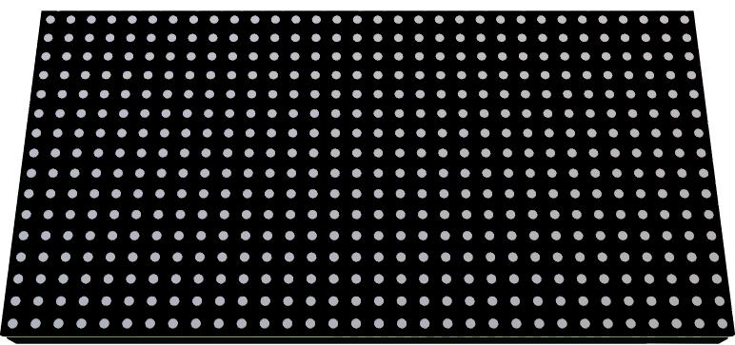
0
1
2
3
4
5
6
0
1
2
3
4
5
6
The Clients Request
0
min
+
Visible from up to 10 meters

Slide 8

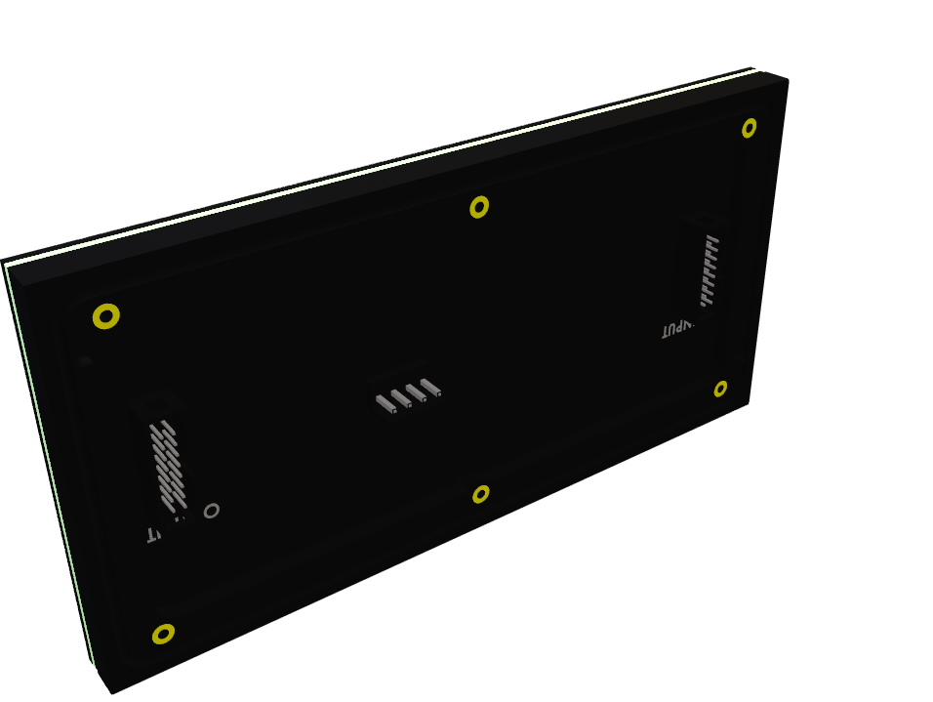
0
1
2
3
4
5
6
0
1
2
3
4
5
6
The Clients Request
0
min
+
Cordless

Slide 9

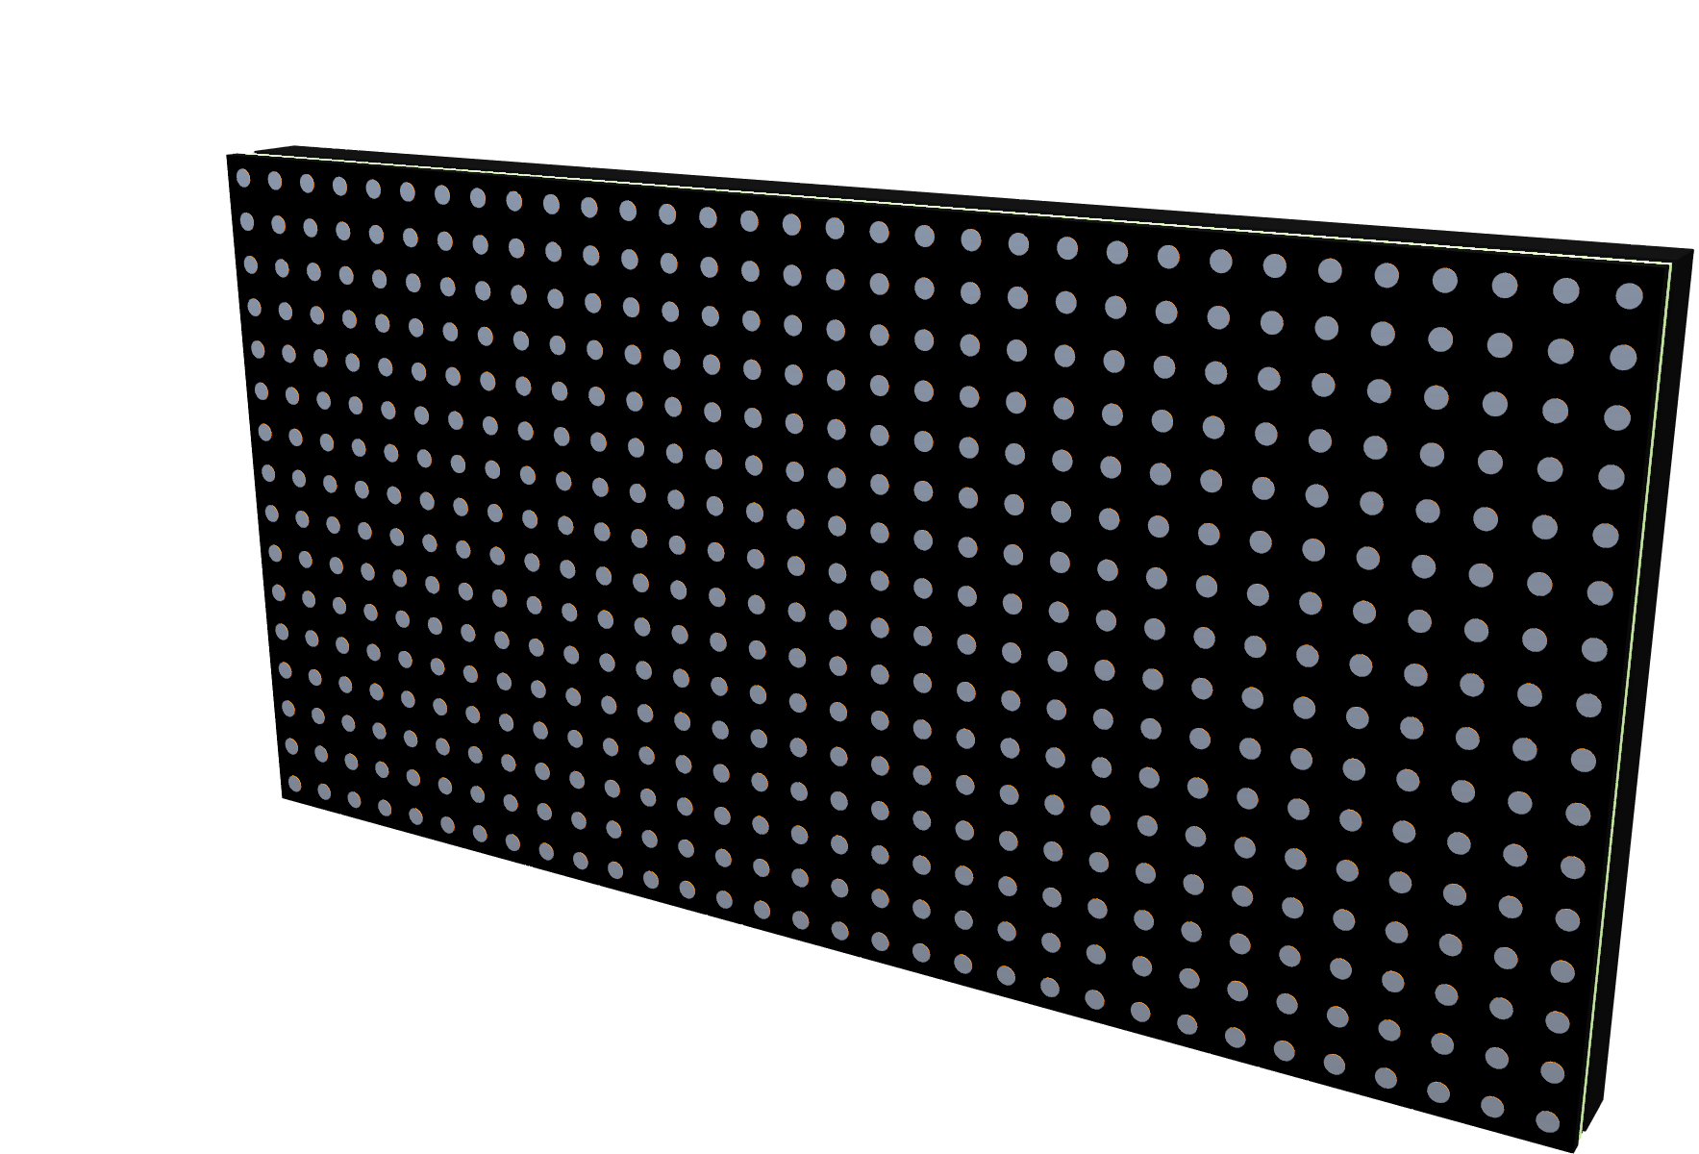
0
1
2
3
4
5
6
MATRONIX’S VISION
0
1
2
3
4
5
6
The Clients Request
0
min
+
Portable

Slide 10
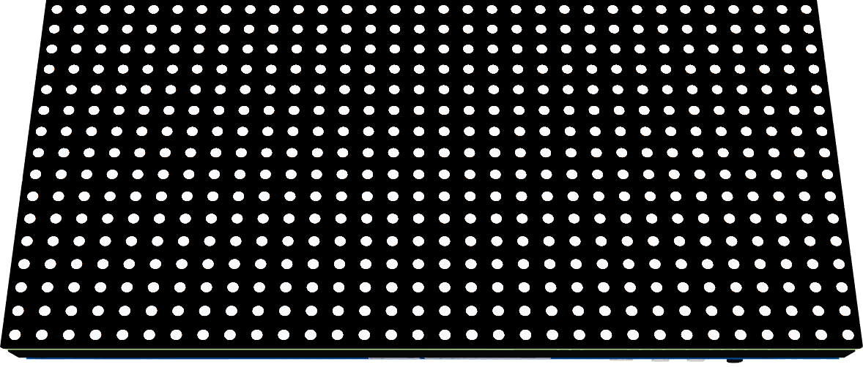



0
1
2
3
4
5
6
SOLUTION
The Clients Request
MATRONIX’S VISION
0
min
+
Moveable

Slide 11
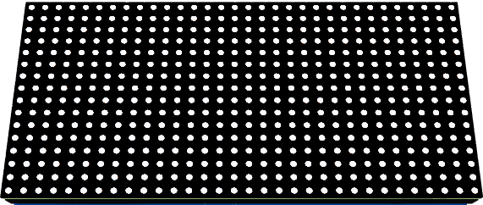
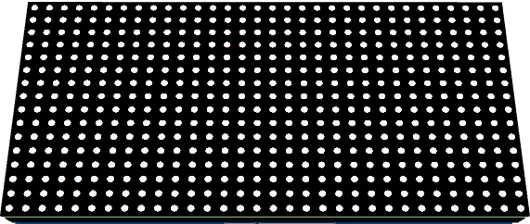
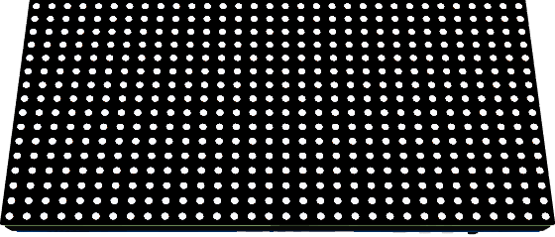

MATRONIX’S VISION
The product will include 4 modular displays to extend readability and function

Slide 12


MATRONIX’S VISION
Automatic text/graphics size adjustment based on the number of displays connected.

Slide 13
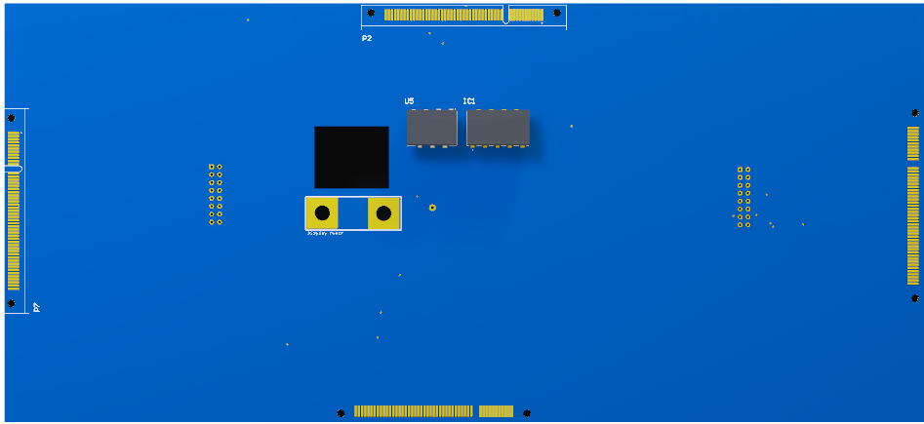
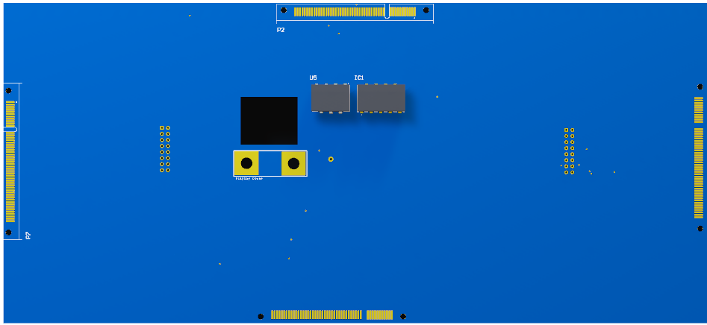
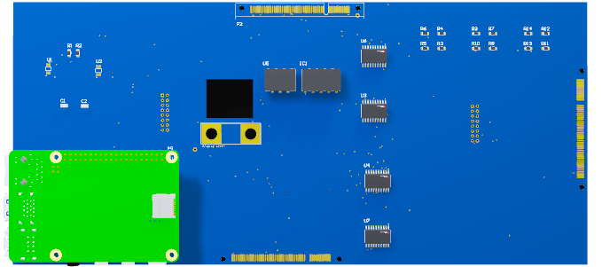
MATRONIX’S VISION
Hot-swappable batteries (4 packs) –with uninterrupted display operation if at least one battery module is connected.
Automatic brightness adjustment based on the number of battery modules connected.

Slide 14
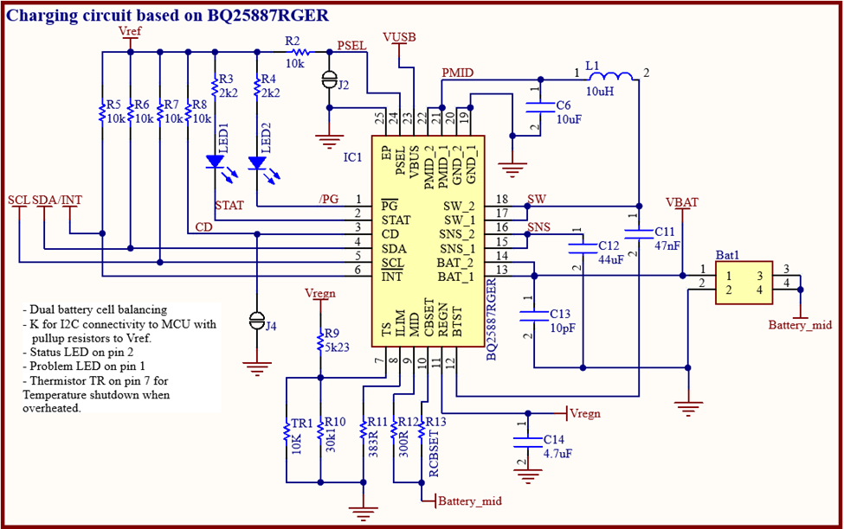
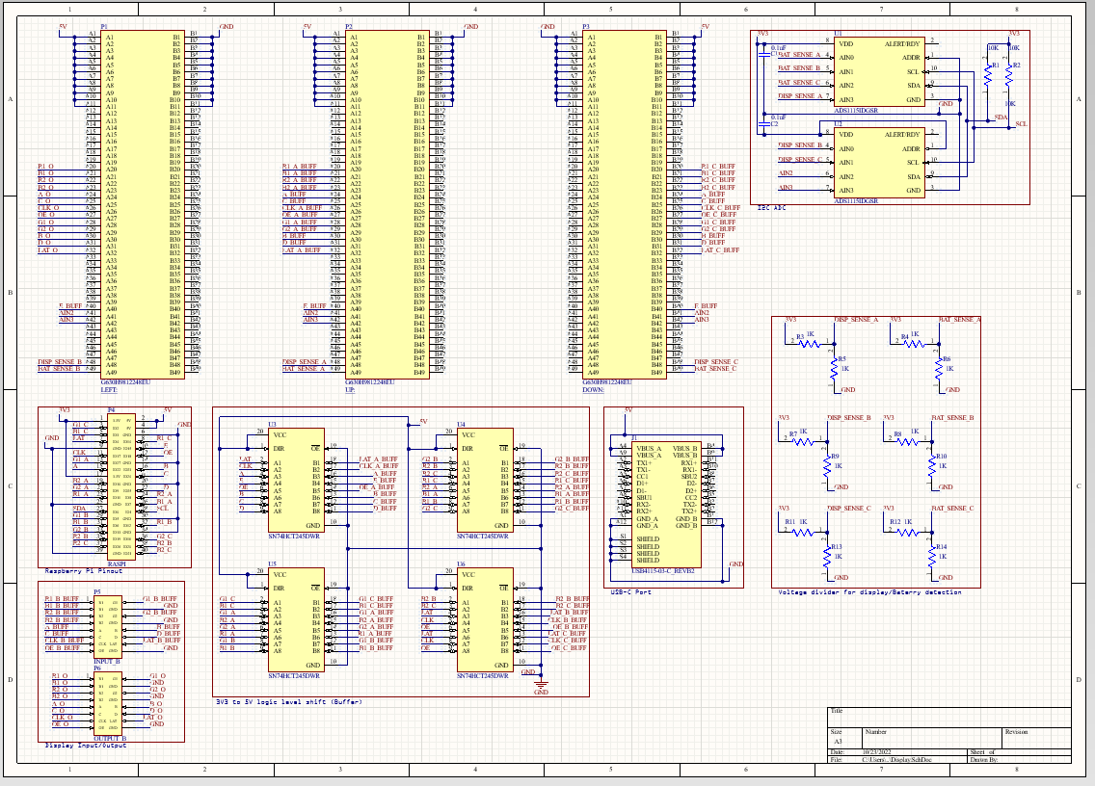
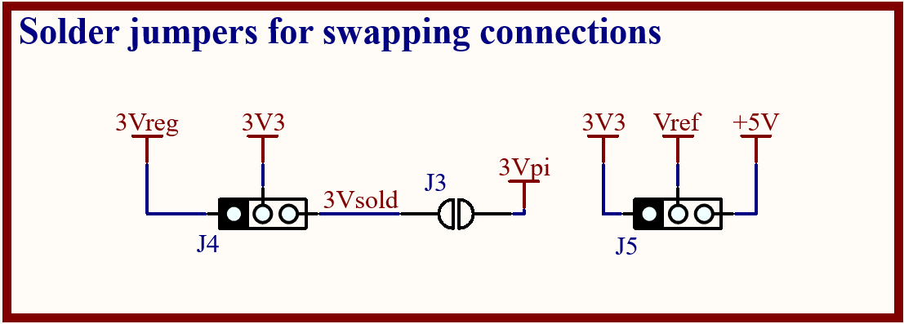
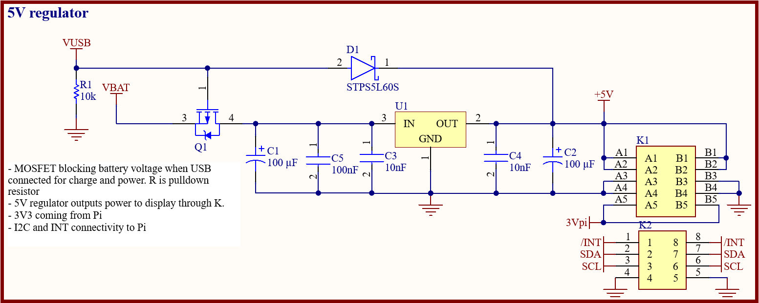
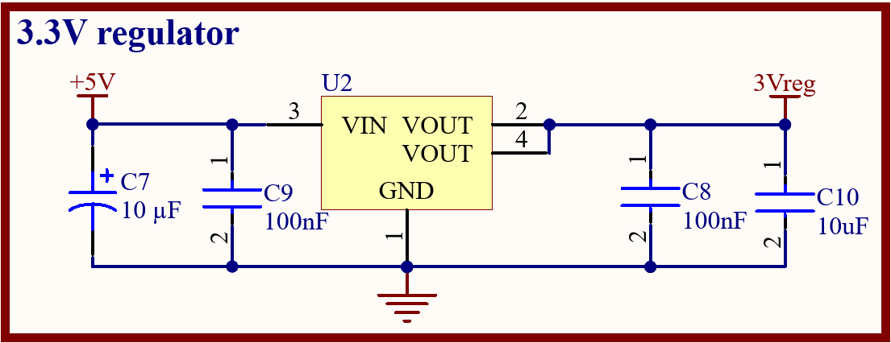
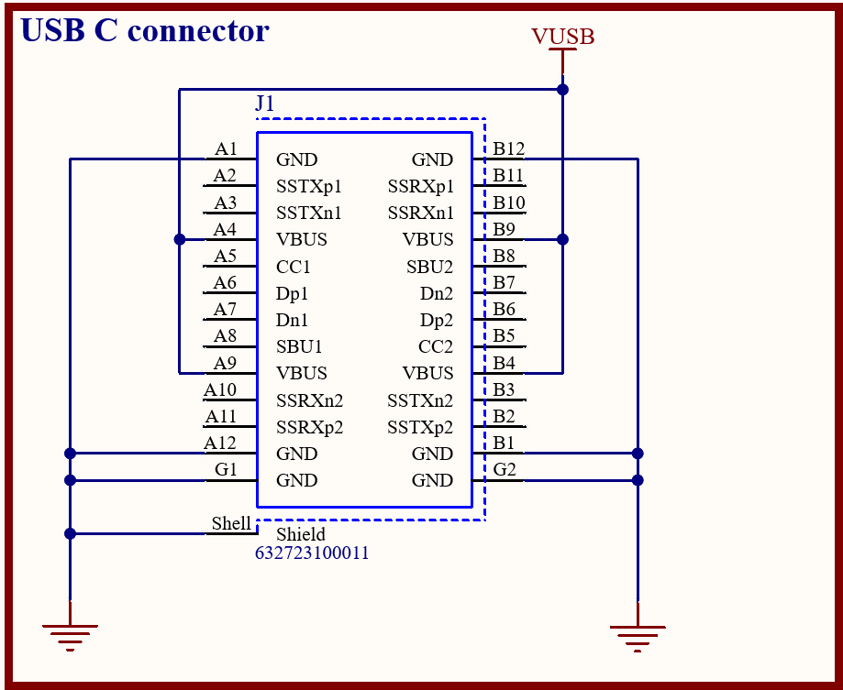
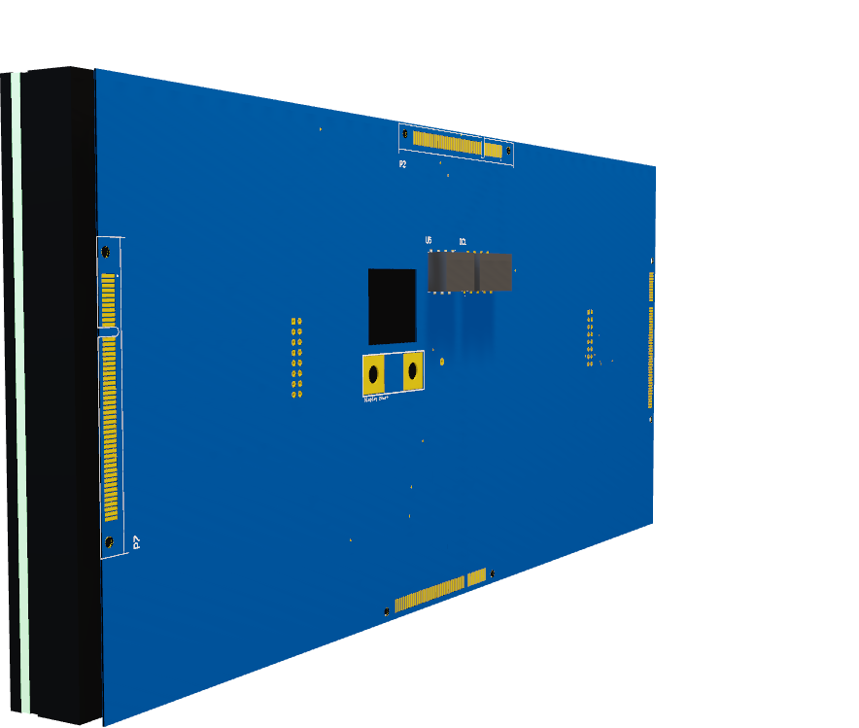
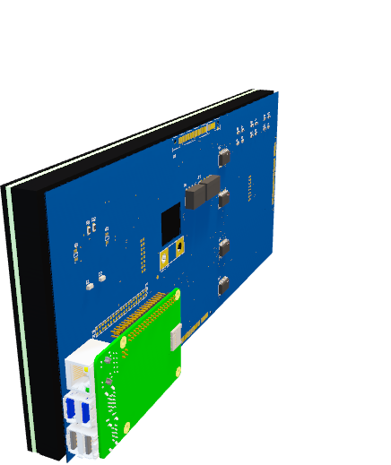
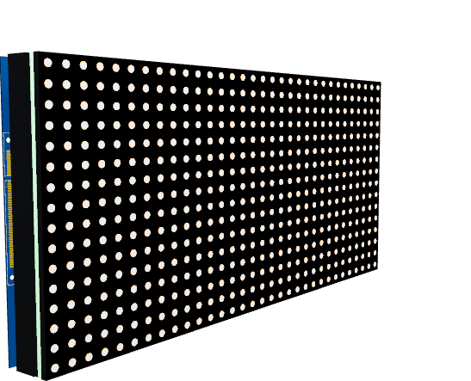
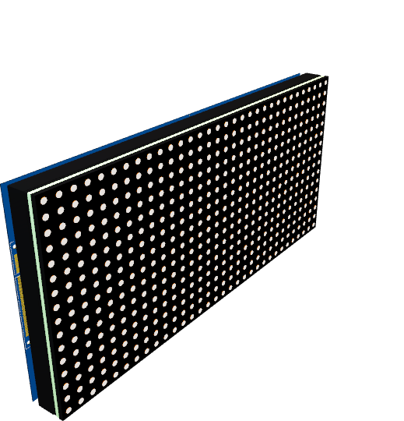
MATRONIX’S VISION
SCHEMATICS
Double-sided displays- allow viewers to watch from both sides.

Slide 15
SCHEMATICS

Slide 20
conclusion
What we've achieved
Finalizing a concept
Creating a solid functional and technical design
Making a prototype of the product
Designing batteries for the modules
What's left ?
Finalizing parts list
Ordering parts
Finalizing schematics
Finalizing PCB Layouts
Ordering PCBs
Programming
Integration testing
Final Report

Slide 21
Questions?

